Slide 1

Screen Time Patterns and Health Impact Among Indian Children (Ages 7–18)

Slide 2

Agenda
Objectives
Dataset Overview
Avg Screen Time by Age
Screen Time by Gender
Urban vs Rural
Educational vs Recreational
Device Distribution
Health Impact

Slide 3

Objectives
To analyze daily screen time patterns among children
To study its impact on health
To compare usage across age, gender, and region
To understand device preferences

Slide 4
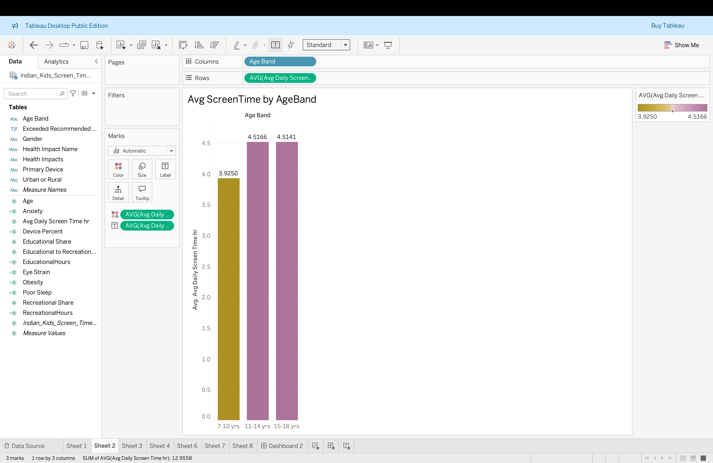
Avg Screen Time by Age
7–10 yrs → 3.93 hrs/day
11–14 yrs → 4.52 hrs/day
15–18 yrs → 4.51 hrs/day

Slide 5
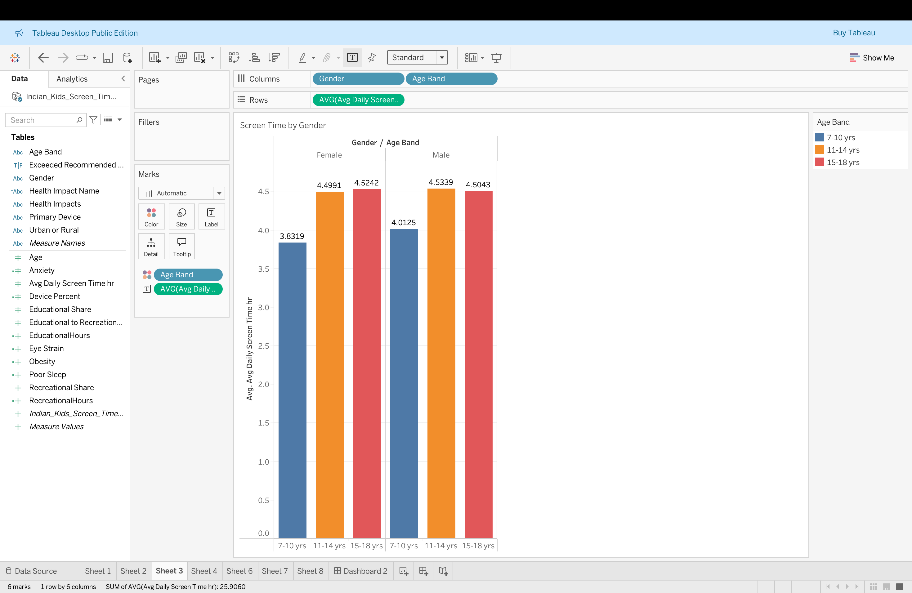
Screen Time by Gender
Boys have slightly higher screen time
Both boys & girls peak at 15–18 years ✅ Gender impact is small but consistent

Slide 6
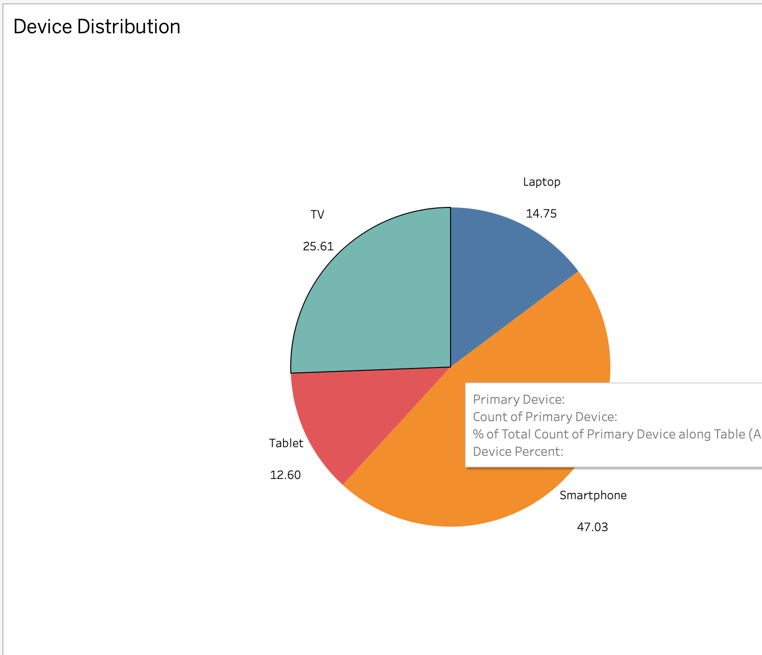
Device Distribution
Smartphone – 47%
TV – 26%
Laptop – 15%
Tablet – 13% ✅ Smartphones are the main digital device

Slide 7
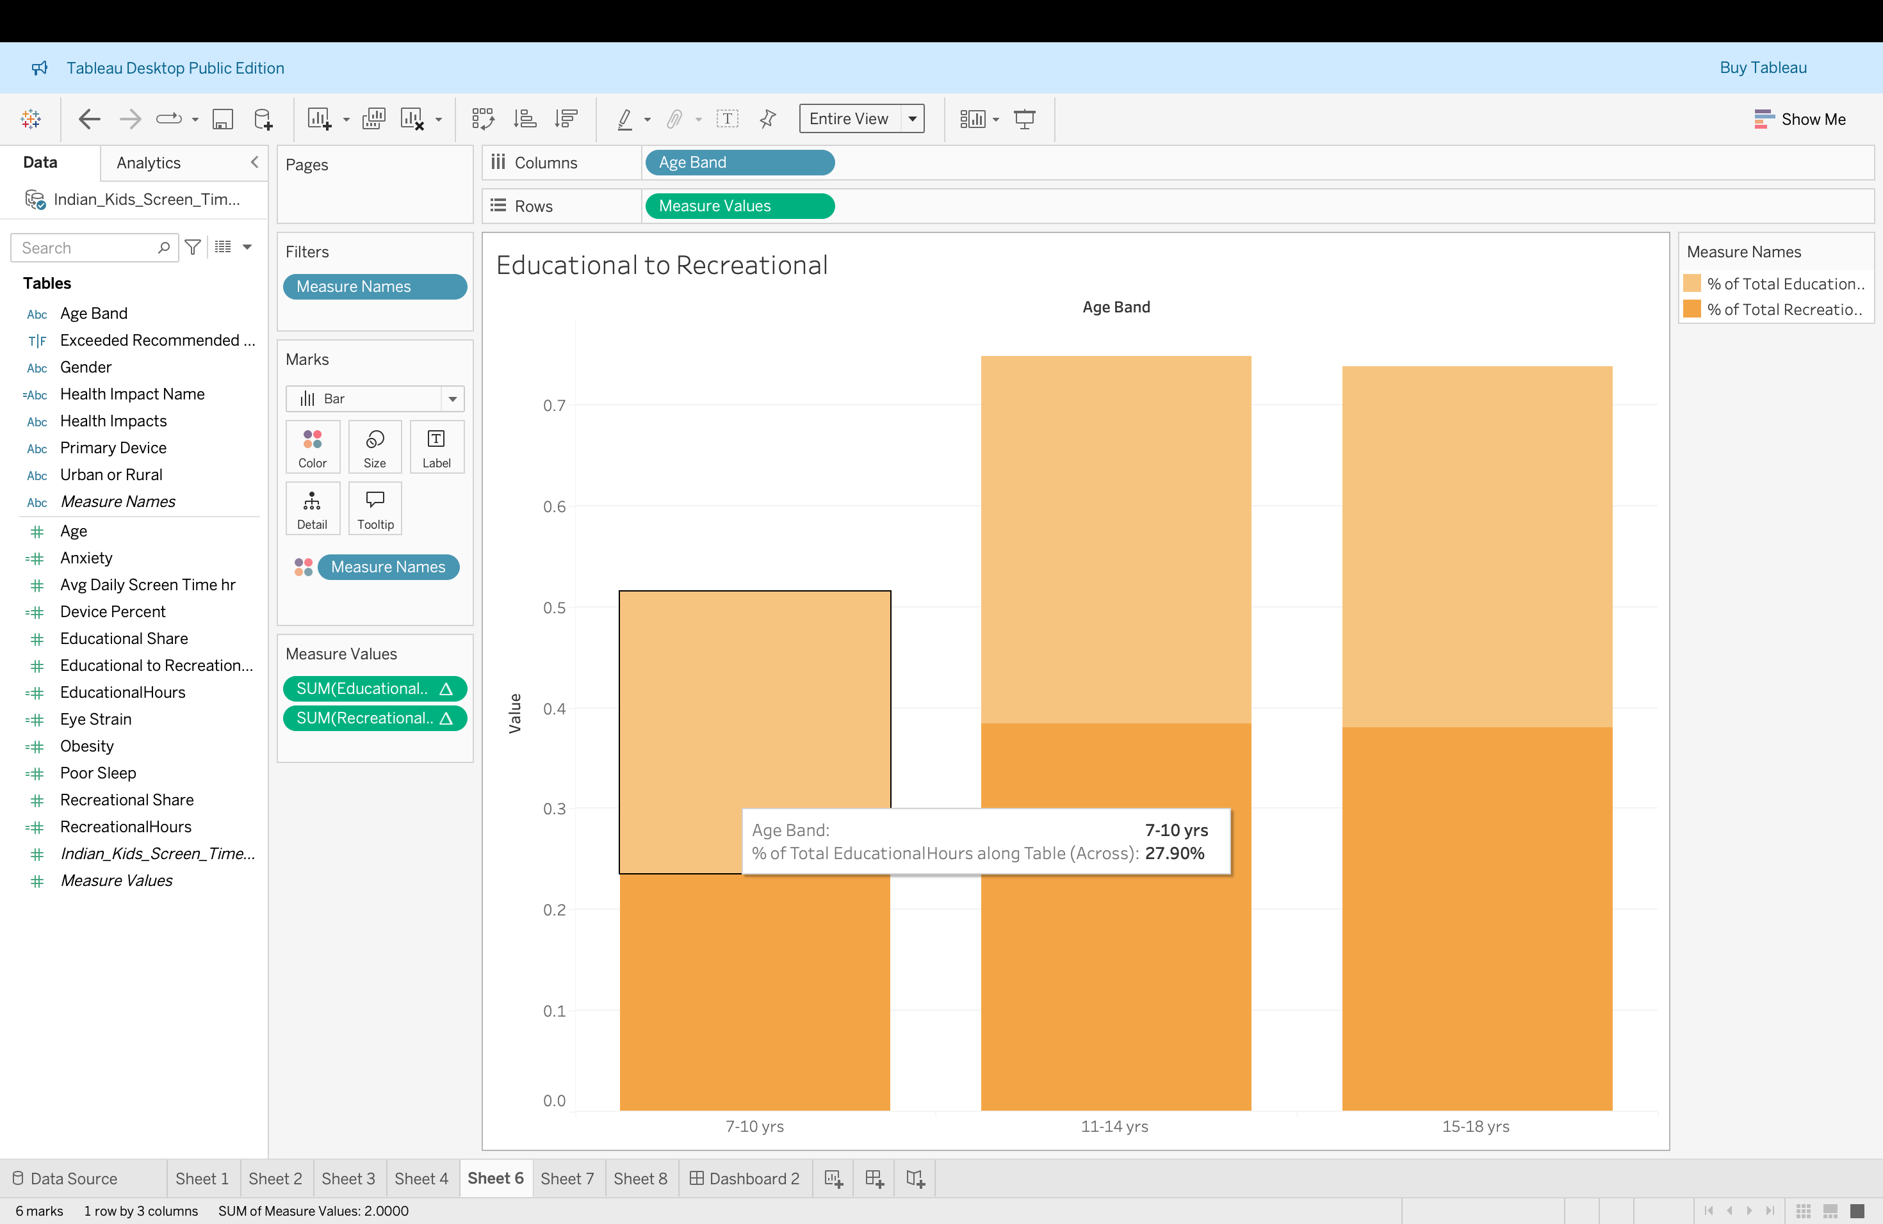
Educational vs Recreational
7–10 yrs → Educational dominates
11–14 yrs → Balanced
15–18 yrs → Recreational dominates ✅ Entertainment usage grows rapidly with age

Slide 8
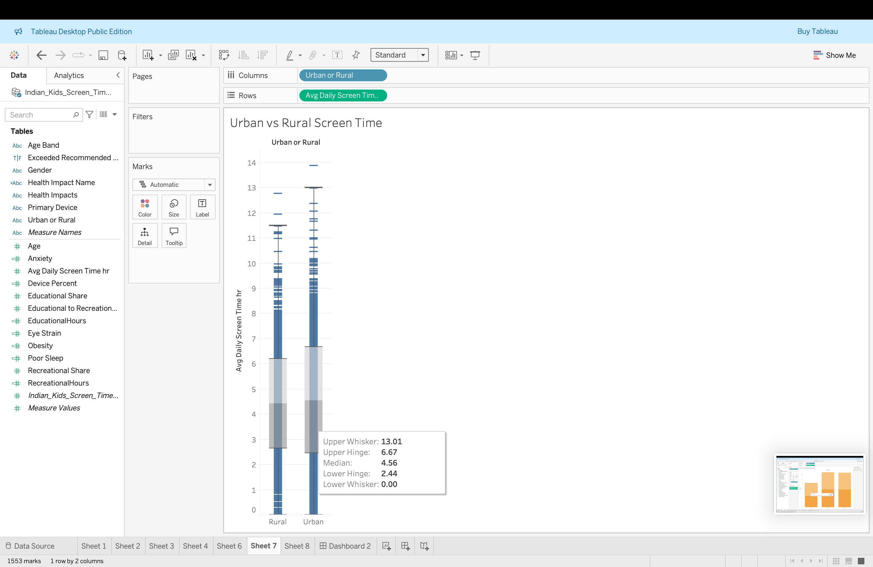
Urban vs Rural
Urban children show:
Higher average usage
Higher maximum values (up to 14 hrs/day) ✅ Urban lifestyle increases digital exposure

Slide 9
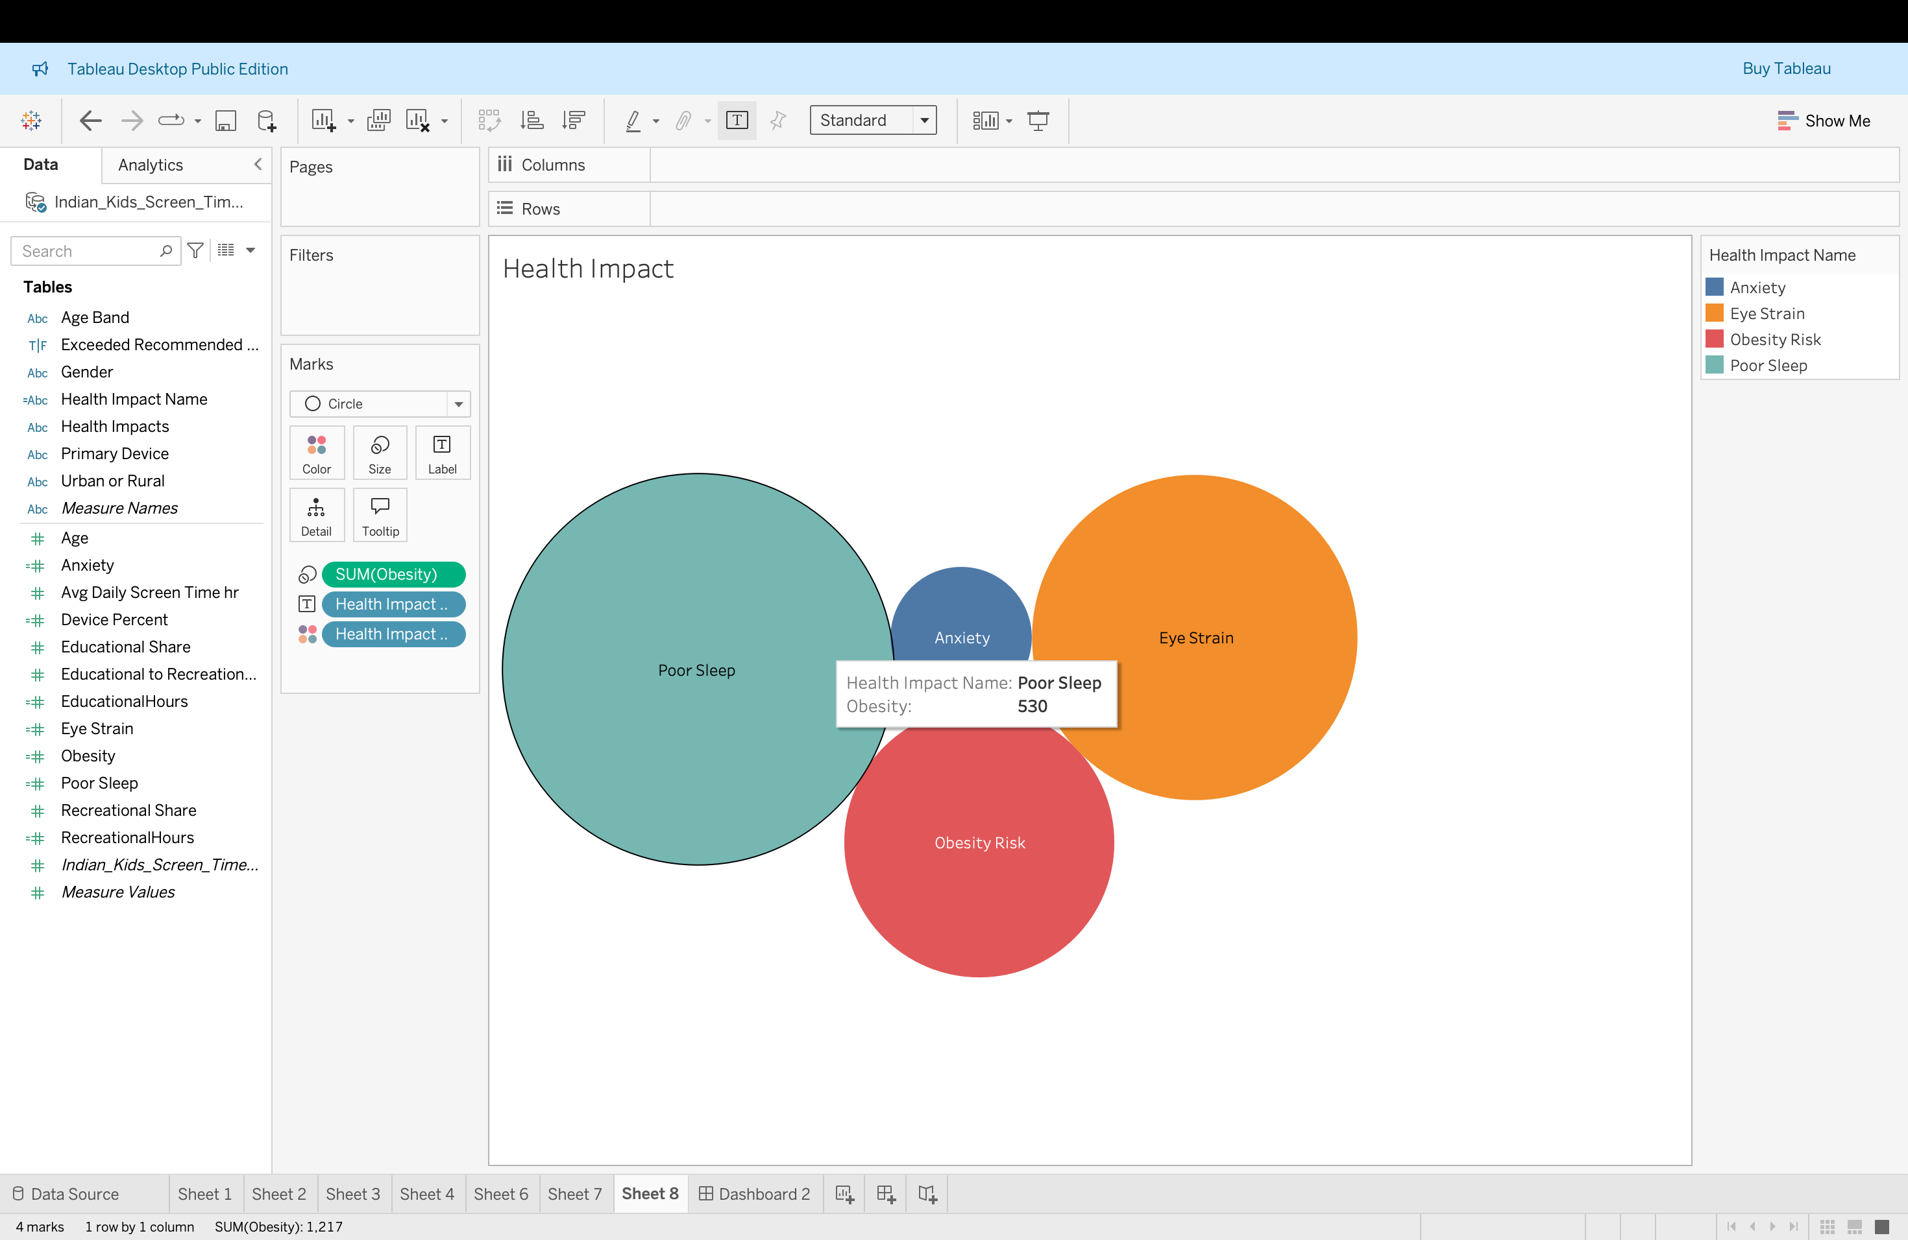
Health Impact
Poor Sleep – Highest impact
Eye Strain – Second highest
Obesity Risk – Moderat

Slide 10


Slide 11
Key Findings
Screen time increases with age
Urban > Rural screen exposure
Smartphones dominate usage
Poor sleep & eye strain are major health risks
Recreational usage overtakes education

Slide 12
Recommendations
Daily screen time limits
Promote outdoor activities
Encourage educational apps
Use blue light protection
Conduct digital wellness programs in schools

Slide 13

Thank you
Pooja P

